Slide 1
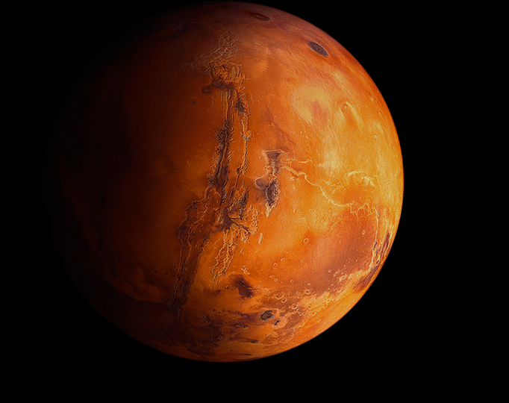
The Solar Cycle and Mars
Is there a correlation?

Slide 2
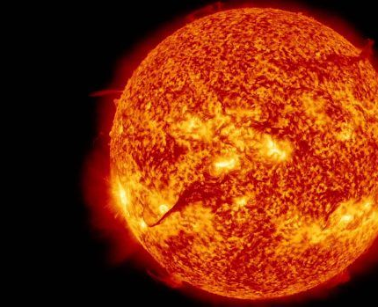
The Solar Cycle?
+ The Solar Cycle is the Sun’s magnetic cycle, in which it’s poles reverse. This happens roughly every 11 years, ending in either a Solar Maximum or a Solar Minimum ( a total of roughly 22 years)
+ included in these changes is an increase in the number of sunspots (darker, cooler areas of the sun)
+ Experts in the field agree that the solar cycle is not a driving force in the Earth’s Climate Change

Slide 3
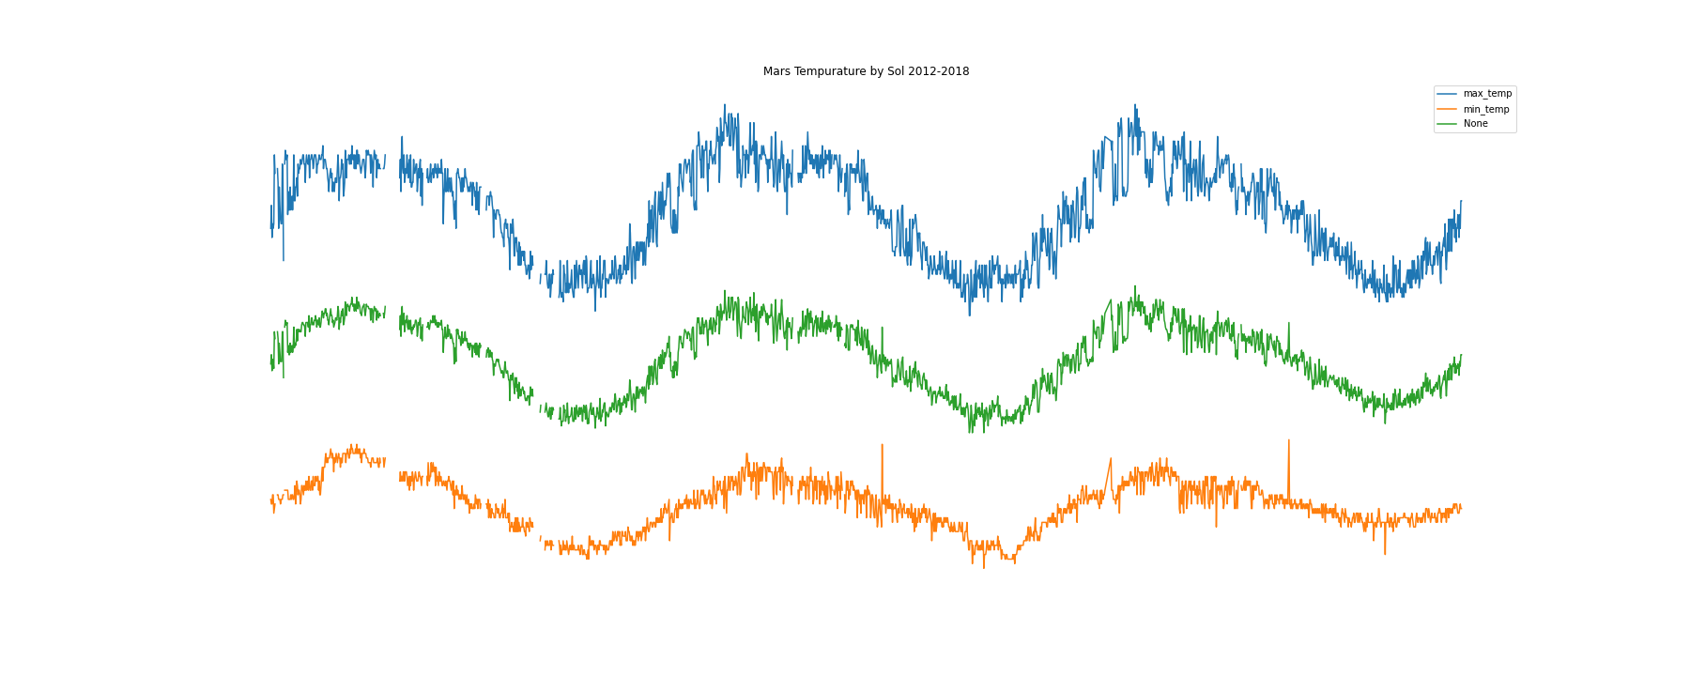
Why Look at Mars?
+ Mars does not at present moment, have any oceans. As far as we are aware, there are no living things on Mars to interfere with the climate. The fewer Variables, the more accurate the analysis.
+ There is an ever-increasing push to send people there
Temperature Change by Sol from 2012 - 2018

